Slide 1

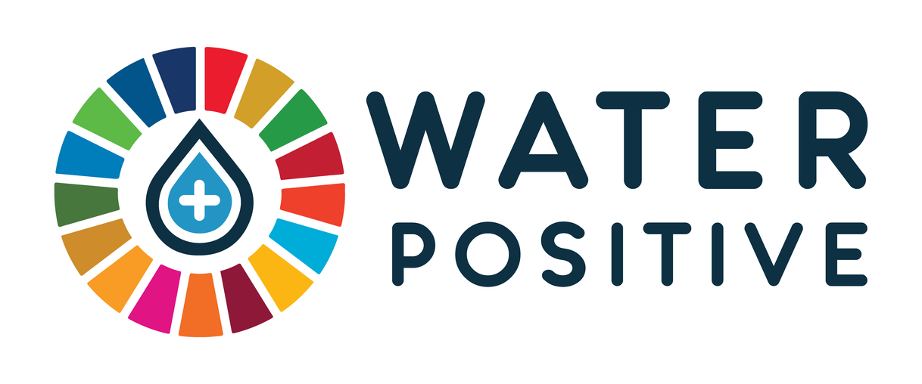
Water Positive
“Water Positive Training 2024”
The Water Positive Think Tank

Slide 2

About This Training
This training brings together all the knowledge we have gathered to date, aimed at sharing valuable insights and fostering a deeper understanding of sustainability.
The Water Positive initiative represents a transformative approach to how we interact with water as a vital resource. It goes beyond merely preserving water; it advocates for a balance where we protect the environment while fostering economic growth. This initiative demonstrates that sustainability does not mean limiting opportunities or leaving people behind. On the contrary, it empowers us to discover innovative ways to use water responsibly, ensuring that communities and businesses alike can thrive without depleting or damaging our natural resources.
By rethinking water management in this way, the Water Positive initiative promotes an inclusive model—one that encourages progress and development while safeguarding the future of our planet. It proves that sustainable solutions are not only environmentally sound but also socially and economically beneficial.
Finally, we would like to extend our heartfelt thanks to Graciela Chichilinsky, Will Sarni, Domingo Zarzo, Gabriel Blejman and Eduardo Orteu, for generously sharing his knowledge with us, contributing to the success of this training in a selfless and invaluable way.

Slide 3
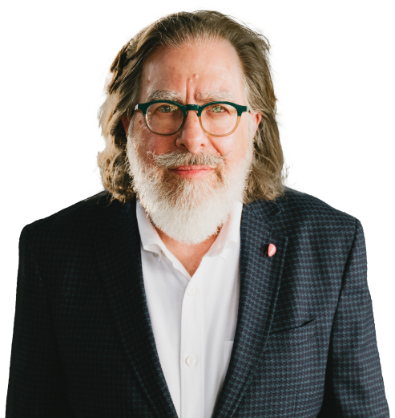
Our Compass
WILL SARNI
I believe that viewing nature and water as outside the human condition results in a devaluing of water. Water has social and spiritual dimensions that are mostly ignored.
I can’t accept that a large part of humanity doesn’t have access to safe drinking water due to scarcity or poor quality. This is a human right that we no longer can ignore. I believe in a bias for action, not accepting business as usual, and the power of unreasonable people.
Wicked water problems can be solved through innovation in: partnerships, funding and financing, business models, technology, and public policy. Our runway to address these issues is short and the time is now to move beyond outdated thinking and frameworks to address these issues.
“Unreasonable people” will be the ones that solve, or tame, wicked problems such as water, climate, ecosystem decline, and other environmental and social problems.

Slide 4

Net-Zero Carbon
Net Zero Carbon refers to the balance between the amount of greenhouse gas produced and the amount removed from the atmosphere. We reach net zero when the amount we add is no more than the amount taken away

Slide 5

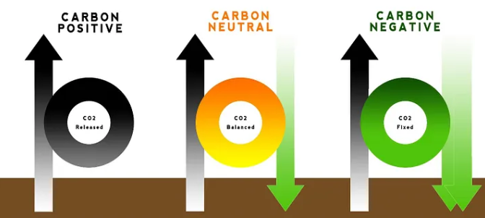
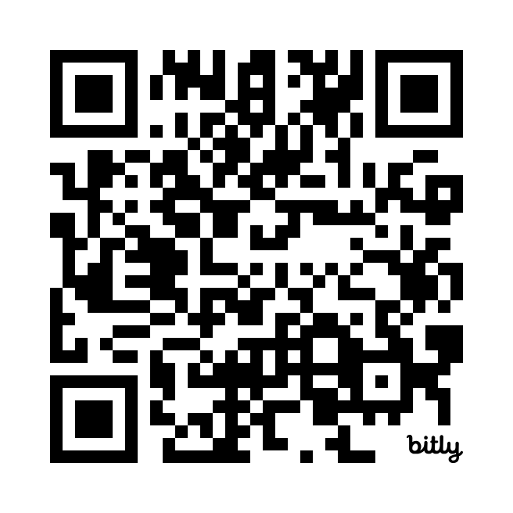

Who Pioneered the 'Water Positive' Concept?
"Water Positive" concept originates in the construction industry in the early 2000s to reduce environmental impact.
Global expansion driven by the UN Millennium Development Goals in the 2000s.
Beverage companies like Coca-Cola and PepsiCo pioneer water positivity commitments.
By 2015, more companies commit to being "Water Positive" by 2030-2050.
In 2021, the inclusion of non-traditional water resources through desalination technologies is introduced.
In 2023 The Water Positive Think Tank is formed to support water sustainability in Industry

Slide 6


Graciela Chichilnisky
The "architect of the Kyoto Protocol's carbon market"

Slide 7

Graciela Chichilnisky
"The first principle for creating change that is real is to make that change profitable."

Slide 8
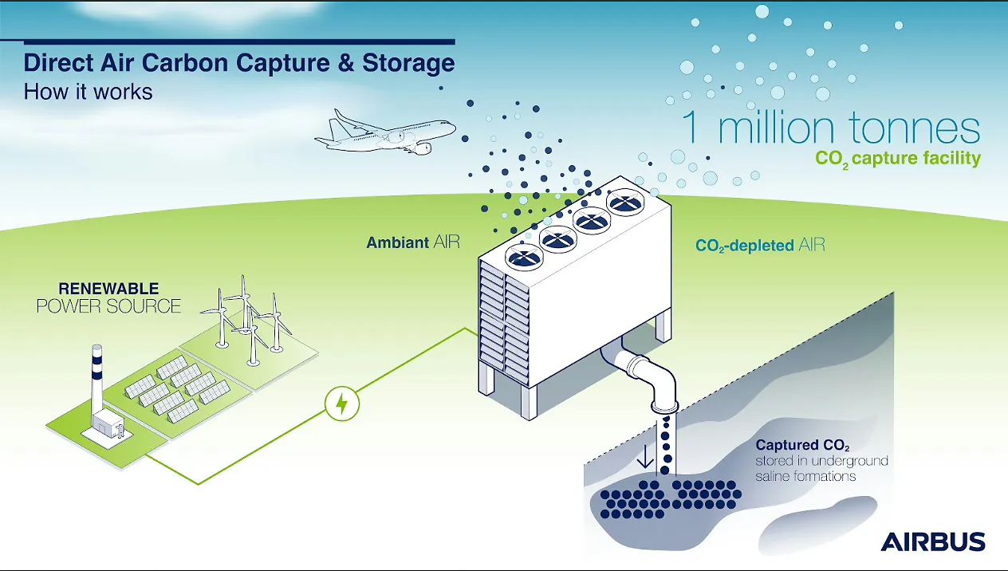

Slide 9
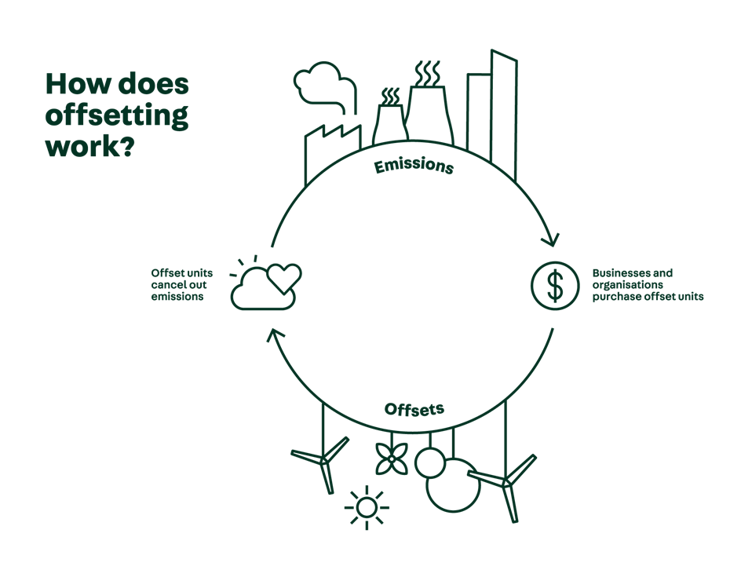
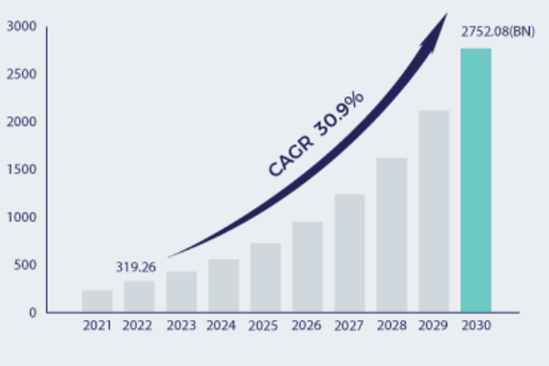
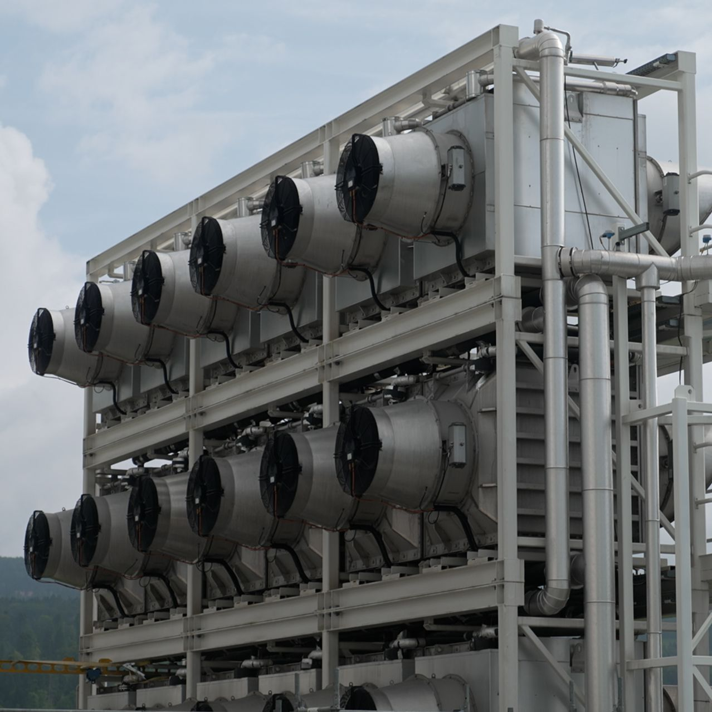
Global Carbon Offset/Carbon Credit Market (USD Billion) - Global Forecast For 2023-2030
The voluntary carbon market has shown resilience and adaptability, with a clear trend towards high-quality, high-integrity carbon credits.
Opportunities
Expansion of the carbon offset projects
Increasing environmental concern with government support
In 2023, the market experienced a notable shift towards higher integrity and quality carbon credits.
Growth Trends
2015-2019 the market grew 40%
2019-2020 71% increase
2020 to 2021 almost doubled
2019 to 2022 more than tripled
Direct Air Capture

Slide 10
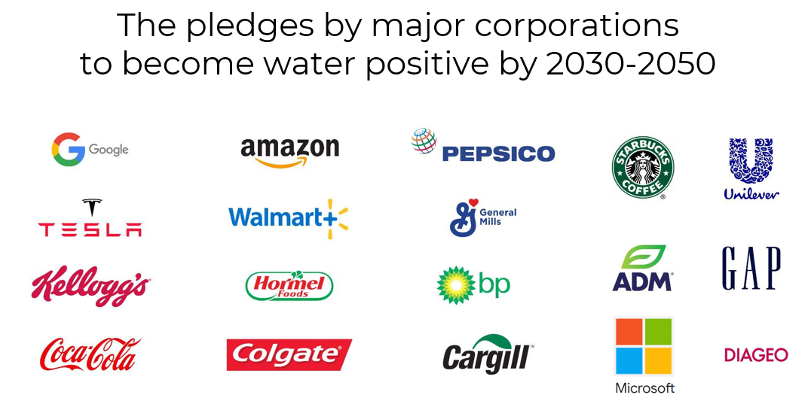
The pledges by major corporations
to became Water Positive by 2030-2050
Over 350 companies have signed the CEO Water Mandate and committed to becoming water positive, investing to return more water than they use.

Slide 11
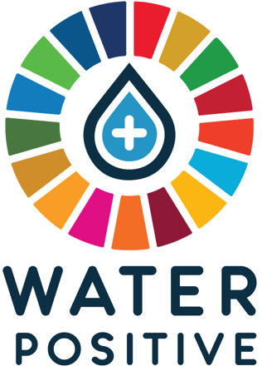
Definition
The concept of Water Positive can be defined as the concept where an entity, such as a company, community, or individual, goes beyond simply conserving water and actively contributes to the sustainable management and restoration of water resources. This involves implementing practices and technologies that reduce water consumption, improve water quality, and enhance water availability.
The goal of being water positive is to leave a positive impact on water resources and ensure that more water is conserved and restored than is used or depleted.
The 3 dimensions (Net Positive Water Impact, NPWI):
Quantity
Quality
Access (Geo-localization)

Slide 12
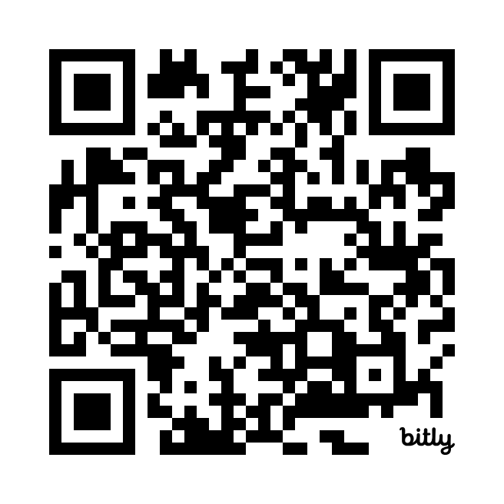
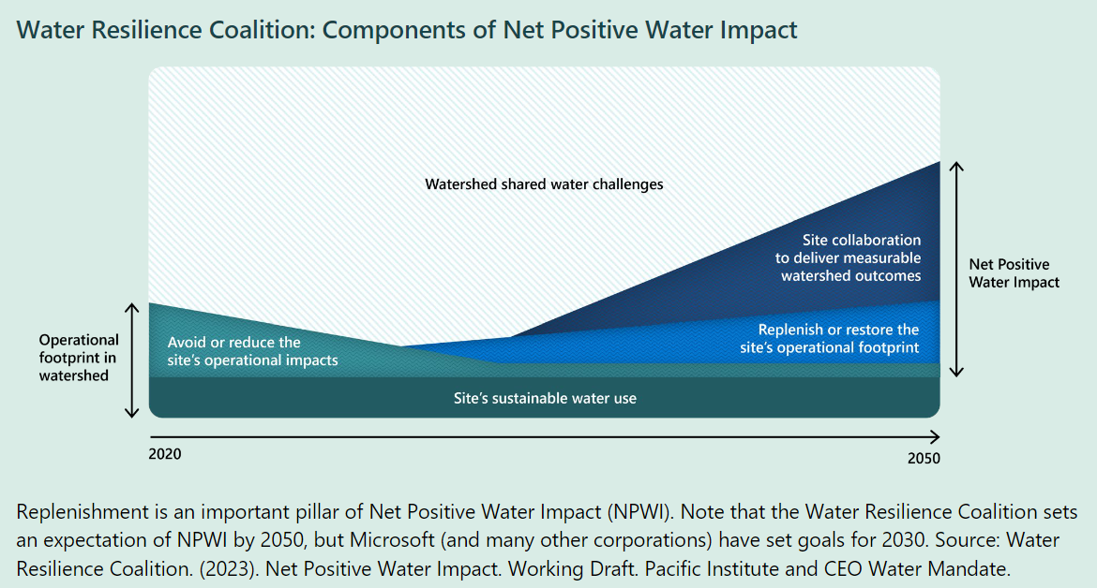

Microsoft learnings on the journey to Water Positive

Slide 13
The Environmental Footprint
Water
Footprint
Water Positive
Economy
Social
Water Footprint Trade

Slide 14

Water Footprint
The water footprint is an environmental indicator that defines the total volume of freshwater used to produce the goods and services we routinely consume (as an individual, community, or business).
Water Footprint Standards:
The Water Footprint Assessment Manual (WFN)
ISO 14046:2014
Global Reporting Initiative (GRI - GRI 303: Water and Wastewater)
Good Water Management Practices and Related Standards:
Alliance for Water Stewardship (AWS)
CDP Disclosure Insight Action
Science Based Targets initiative (SBTi)
Volumetric Water Benefit Accounting (VWBA)
WWF’s Water Risk Filter:
It's important to note that while the Water Footprint Standars are specifically about quantifying water footprint, the others (AWS, CDP, and SBTi) are more focused on overall water management, stewardship, and target-setting. These latter initiatives can complement water footprint assessments but serve different primary purposes.
Green water footprint: fraction of the footprint that comes directly from rainwater or snow and is stored in the soil in surface layers within reach of plants.
Blue water footprint: Water that comes from natural or artificial sources through man-made infrastructure or facilities.
Grey water footprint: Water polluted in production processes that subsequently needs to be diluted to comply with sectoral regulations.

Slide 15
Water Footprint
Water Footprint Certifiers (specifically for ISO 14046):
SGS
Bureau Veritas
TÜV SÜD
DNV GL
SCS Global Services
Water Management and Water Stewardship Certifiers:
Alliance for Water Stewardship (AWS) - certifies water stewardship practices
SGS
Bureau Veritas
DNV GL
SCS Global Services
CDP Disclosure Insight Action
Water Footprint Certifiers are likely to be more suitable for meeting CSDDD requirements due to their focus on quantitative measurement and standardized assessment of water use and impacts. This approach aligns well with the CSDDD's emphasis on precise reporting and comparability across companies and sectors.
While water management certifications offer valuable insights into overall practices, the numerical precision and standardized methodology provided by water footprint certifications may prove more advantageous for regulatory compliance and detailed impact assessment required by the CSDDD.

Slide 16
The Environmental Footprint
Water
Footprint
Water Positive
Economy
Social
Water Footprint Trade

Slide 17

Water Footprint Trade
Definition
"Water footprint trade" refers to the exchange of water-intensive goods and services between countries or regions.
Rather than directly trading water, countries/regions essentially "trade" the water embedded in goods and services.
When a water-intensive product is exported, the exporting country is effectively "exporting" the water resources used to produce that product.
It allows water-scarce regions to import goods instead of using their own scarce water resources for production.
Conversely, water-abundant regions can capitalize on their resources by producing water-intensive goods for export.
Challenges
If not managed sustainably, it can lead to the overexploitation of water resources in exporting countries.
Poor understanding of water footprint can lead to misinformed policy decisions.

Slide 18
The Environmental Footprint
Water
Footprint
Water Positive
Economy
Social
Water Footprint Trade

Slide 19
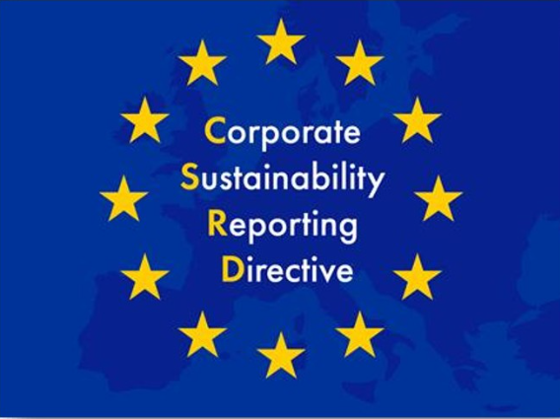
CSRD: The Catalyst for Sustainability Change - Why This Time It's Different?
1.- What is Corporate Sustainability Reporting Directive (CSRD)?
A substantial revision of the Non-Financial Reporting Directive (NFRD) in effect since 2014
Aligns with the European Green Deal goals to make Europe climate neutral by 2050. A major update aimed at standardizing sustainability reporting
Encourages corporate accountability on sustainability issues at a broader level.
2.- What is its objective?
Establishes Environmental, Social, and Governance (ESG) reporting requirements
Significantly expands NFRD in terms of who must report and how
Enhances transparency and quality of reporting
Implements common EU-focused ESRS standards
Homogenizes comparable information between companies
Facilitates transition to sustainability
Integrates ESG criteria

Slide 20
CSRD: The Catalyst for Sustainability Change - Why This Time It's Different?
3.- What changes does it bring?
Independent audits and certification processes
More detailed reporting on environmental impact and human rights based on common EU criteria
Common sustainability standards (ESRS)
Introduces double materiality concept
Includes value chain considerations
Medium and long-term horizon focus
Mandatory sustainability information in electronic format (XHTML)
4.- What is its scope of application?
Large EU companies
Listed SMEs (with exceptions)
Non-EU companies with significant EU operations

Slide 21
CSRD: The Catalyst for Sustainability Change - Why This Time It's Different?
5.- What is double materiality?
Companies must report on:
a) How sustainability issues affect their business (financial materiality)
b) How their activities impact people and the environment (impact materiality)
6.- How is the information verified?
CSRD introduces limited assurance obligation by an independent third party
Verifies that reported information complies with EU standards
Reasonable assurance from 2028, more demanding and based on substantive evidence
Mandatory assurance by an independent auditor or certifier
7.- How does it relate to Corporate Sustainability Due Diligence Directive?
CSRD focuses on reporting, while CSDDD focuses on companies' due diligence processes

Slide 22
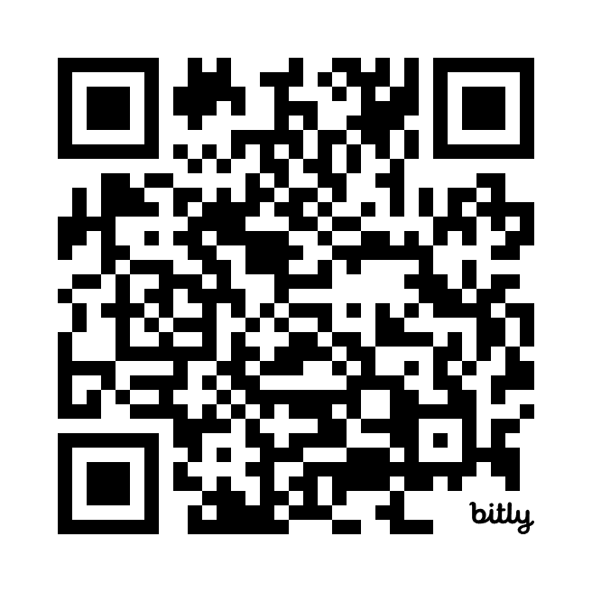
CSRD: The Catalyst for Sustainability Change - Why This Time It's Different?
8.- How does it relate to European Sustainability Reporting Standards (ESRS)?
CSRD mandates use of ESRS for non-financial reporting
ESRS architecture ensures carefully articulated sustainability information communication
9.- When does it come into effect?
Reporting standards will be gradually introduced, allowing companies to adapt their processes.
By 2026, many mid-sized companies will need to comply, significantly broadening the scope.
Companies that already report under NFRD will face stricter requirements under the new CSRD framework.
10.- Where to start?
Assess if your company falls under CSRD scope (or value chain of a covered company)
Familiarize with ESRS and start gathering relevant sustainability data
Consider seeking expert advice or training

Slide 23
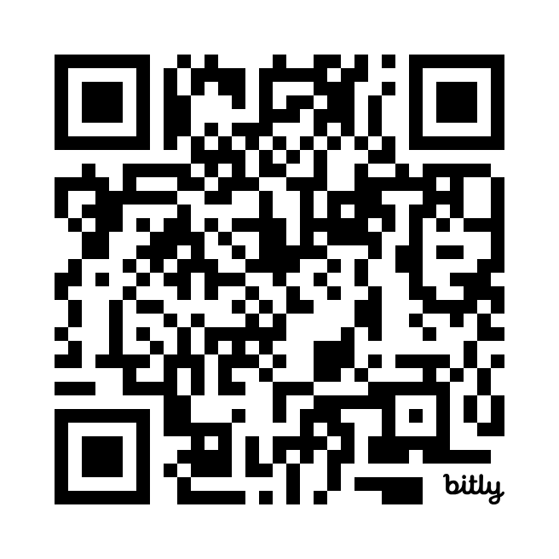
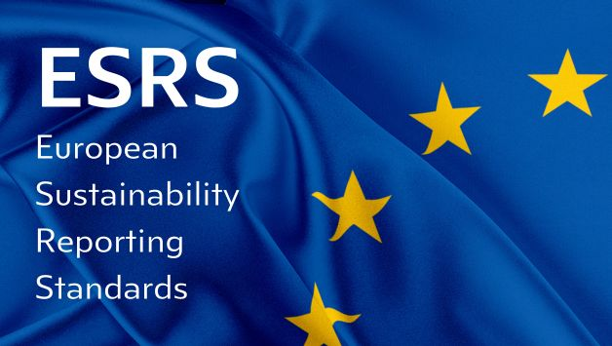
European Sustainability Reporting Standards (ESRS)
On 5 January 2023, the Corporate Sustainability Reporting Directive (CSRD) entered into force. This new directive updates the rules concerning the social and environmental information that companies have to report. Companies subject to the CSRD will have to report according to European Sustainability Reporting Standards (ESRS). These standards were developed by the EFRAG, previously known as the European Financial Reporting Advisory Group, an independent body bringing together various different stakeholders.
There are 12 ESRS, and key aspects to report regarding water include:
Total quantity of water used, reflecting the impacts of business activities on water resources.
Total water recycled and reused.
Identification of significant opportunities and risks associated with water dependency.
Water consumption in areas of high risk and water stress.
Strategies implemented to prevent negative impacts and support broader EU water objectives.
Changes in total water storage.
Water consumption in relation to revenue (optional).
For more information: Daniel Ferrie – Tel.: +32 229 86500; Marta Pérez-Cejuela – Tel.: +32 2 296 37 70

Slide 24
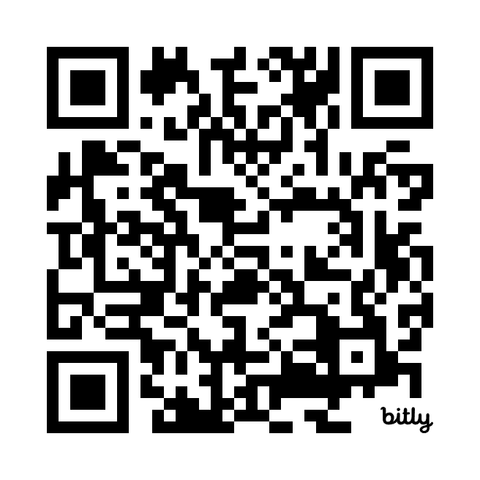
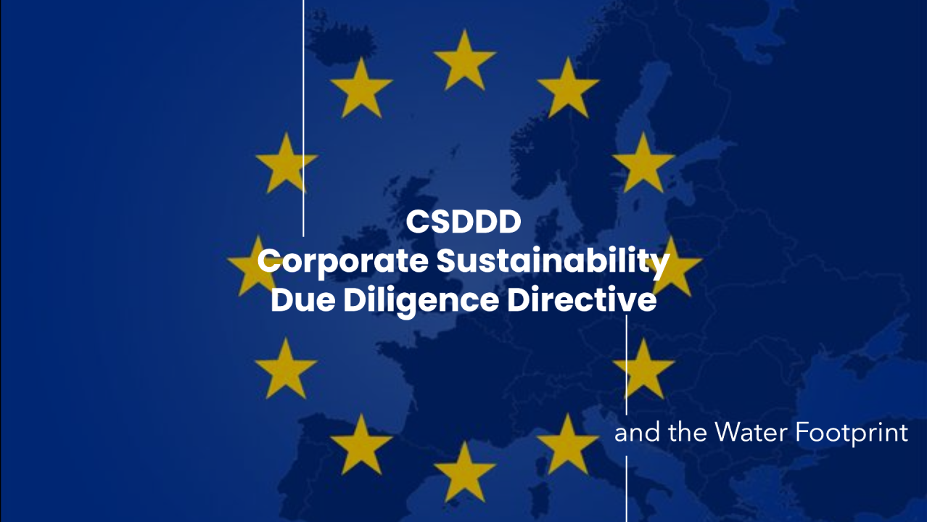
Corporate Sustainability Due Diligence Directive (CSDDD/CS3D)
This directive is a comprehensive policy that requires companies to address sustainability risks and negative impacts across all their business activities. Although its origin is the European Union, its scope is global, also affecting non-European companies that meet certain thresholds.
CS3D timeline: Who has to comply, and when?
The CS3D will be implemented in three phases, depending on the size of the companies:
2027: Companies with more than 5,000 employees and €1.5 billion in turnover.
2028: Companies with more than 3,000 employees and €900 million in turnover.
2029: Companies with more than 1,000 employees and €450 million in turnover.
Benefits of the CS3D for companies
Building resilience to climate risks: Due diligence helps companies identify opportunities and address financial risks related to climate change.
Stronger brand performance: Products with ESG claims have shown higher growth, confirming that responsible business conduct can enhance brand performance and reputation.
Cost savings: Companies can experience significant cost savings by implementing preventative procedures. For instance, the Pollution Prevention Pays program by 3M prevented billions of pounds of pollution while saving over $1 billion.
Avoiding litigation and non-compliance penalties: By complying with the CS3D, companies can avoid costly legal battles and potential fines, which could be as high as 5% of their global revenue.

Slide 25
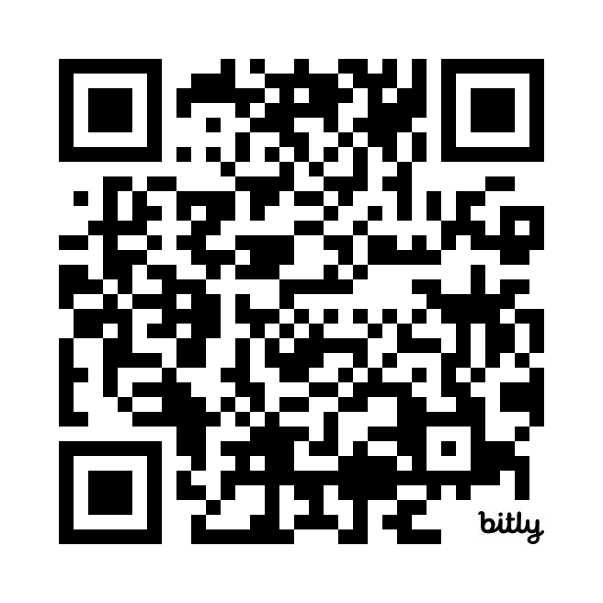

The CSDDD and the Water Footprint
Larger companies in Europe are increasingly assessing the water footprint of their supply chain. Companies have traditionally focused on water use in their operations and ignored the water use in their supply chain. By extending the assessment they will address all water risks associated with their business.
The CSDDD places a significant responsibility on companies to manage their water footprint and virtual water trade across their supply chains. To meet these obligations, companies must identify water-related risks, implement targeted mitigation strategies, and transparently communicate their efforts. Addressing vulnerable regions through local compensations and diversified strategies is essential to minimizing environmental impacts, including pollution from emerging contaminants and declared substances within their value chains. A precise, risk-based approach is needed for effective management.
In a world where water is the most traded resource, sustainable water management is not only a legal requirement under the CSDDD but also an ethical duty to protect future generations. Comprehensive and responsible water management ensures lasting positive impacts on both local communities and the global environment. By addressing direct and indirect water usage, companies can contribute to a more sustainable and equitable global water footprint, aligning their operations with both regulatory frameworks and global sustainability goals.

Slide 26
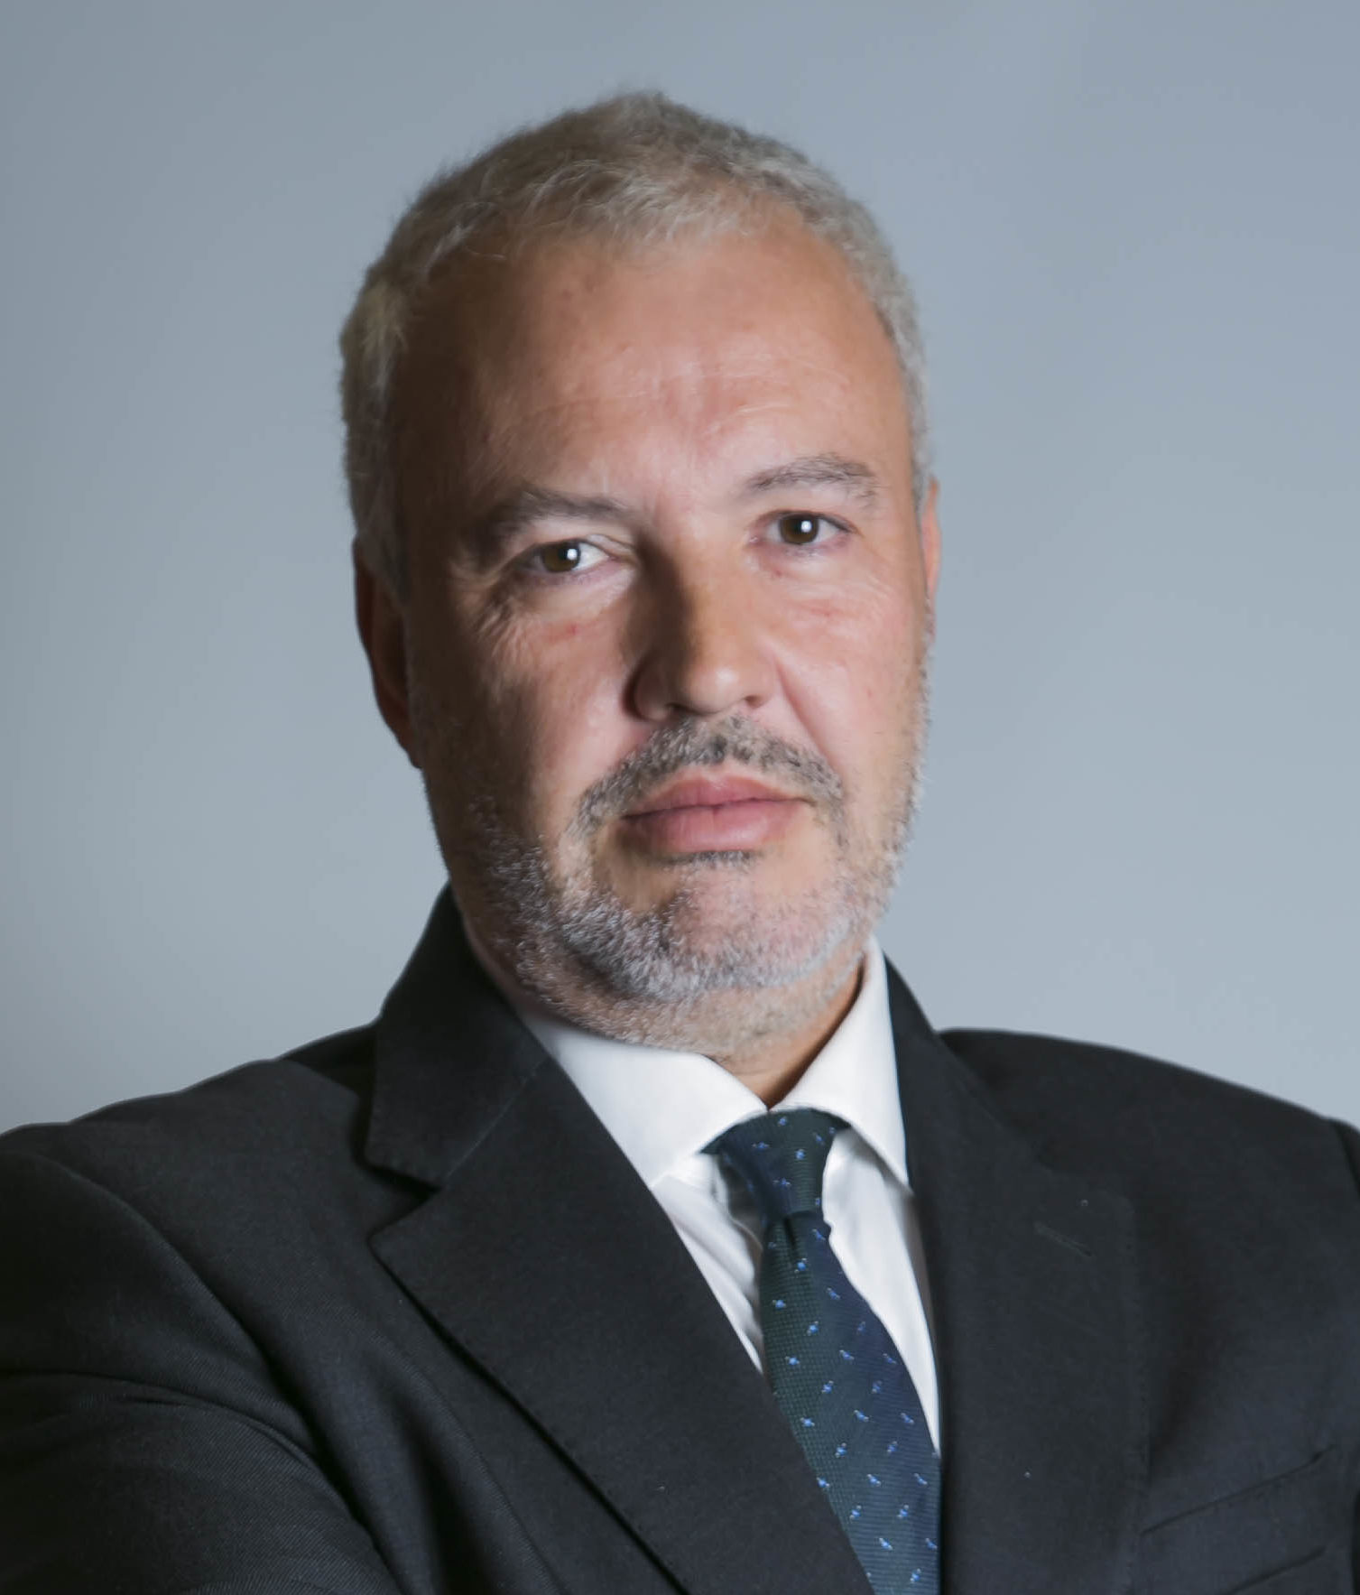
Integration of Environmental Regulations in CSRD and CSDDD: Eduardo Orteu’s Perspective
Both CSRD and CSDDD reference environmental regulations when reporting and assessing compliance. It is essential to mention how these frameworks rely on directives such as the Water Framework Directive or the Urban Wastewater Treatment Directive.
River basin management plans are crucial, as they define, for each river basin, the status of water bodies, the pressures on these bodies, their environmental objectives, and the measures to achieve them.
Companies must report whether their investments aimed at mitigating impacts and addressing risks are aligned with the EU Taxonomy Regulation, particularly in relation to water, such as meeting the objectives of the Drinking Water Directive and the Urban Wastewater Treatment Directive.
CSRD and CSDD develop the EU Green Deal and its Action Plan on financing sustainable growth with the aim of driving private investment towards the achievement of the EU environmental goals and aligning business and industrial practices with the exiting EU environmental regulation.
Mr. Eduardo Orteu, Expert in EU Taxonomy Regulation

Slide 27

What Does It Mean to Be Water Positive?
Becoming water positive is more than applying good water stewardship practices or simply being part of the process of generating a positive impact—it’s about creating measurable and lasting improvements for the environment and future generations.
A company is water positive when:
It generates more water benefits than it consumes.
Its actions are intentional, additional, and permanent.
Independent third-party verification ensures transparency and accountability.
Intentionality: Deliberate actions to address water challenges.
Additionality: Benefits that wouldn’t occur without the company’s intervention.
Permanence: Long-lasting, verifiable water benefits.
Why It Matters for Companies:
Ensures real impact on water resources.
Enhances corporate sustainability reputation.
Drives accountability and transparency through third-party verification.
Mrs. Esther Gonzalez
Lawyer Specializing in Water Resources

Slide 28
How Water Benefits Work?

Slide 29
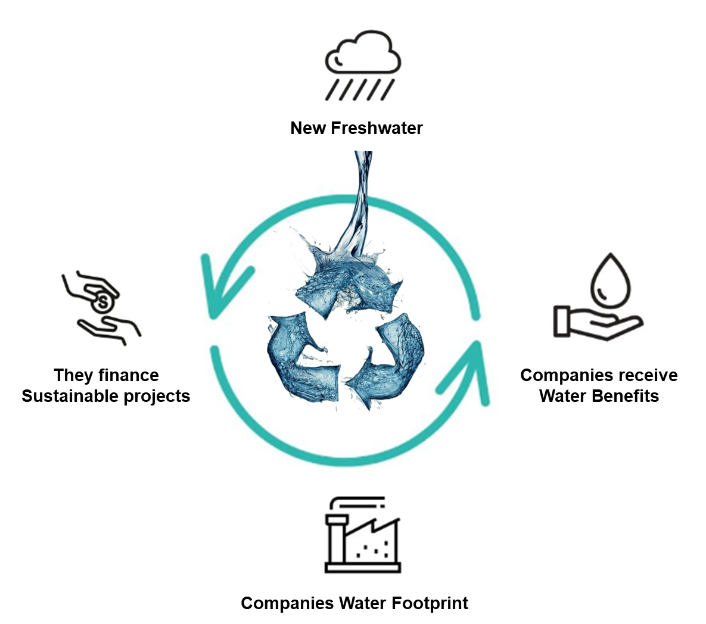
How Water Benefits Work?
Volumetric water benefits offer an innovative approach for companies to compensate for their water use by investing in projects that save, conserve, purify, or protect water locally or elsewhere.
The first step is to improve water efficiency and reduce direct water use. However, to address the indirect water impact from the supply chain and commercialization, volumetric water benefits provide a complementary solution.
In line with the CSDDD, companies must ensure that their entire value chain operates sustainably, including suppliers and business partners. Volumetric water benefits help compensate for indirect water usage by creating or protecting equivalent volumes of water elsewhere.
Furthermore, under the Corporate Sustainability Reporting Directive (CSRD), companies are required to disclose their sustainability practices using the European Sustainability Reporting Standards (ESRS). Incorporating volumetric water benefits into their sustainability strategy allows companies to meet these transparency requirements while demonstrating their commitment to long-term water stewardship.
By investing in these projects, companies can achieve water neutrality or even generate more water than they consume, contributing positively to local ecosystems and supporting high-quality water for agriculture or human consumption.
This dual approach—combining water efficiency with volumetric water benefits—ensures a comprehensive and sustainable water management strategy, aligned with the CSDDD and CSRD regulations, while promoting transparency and accountability throughout the entire value chain.

Slide 30
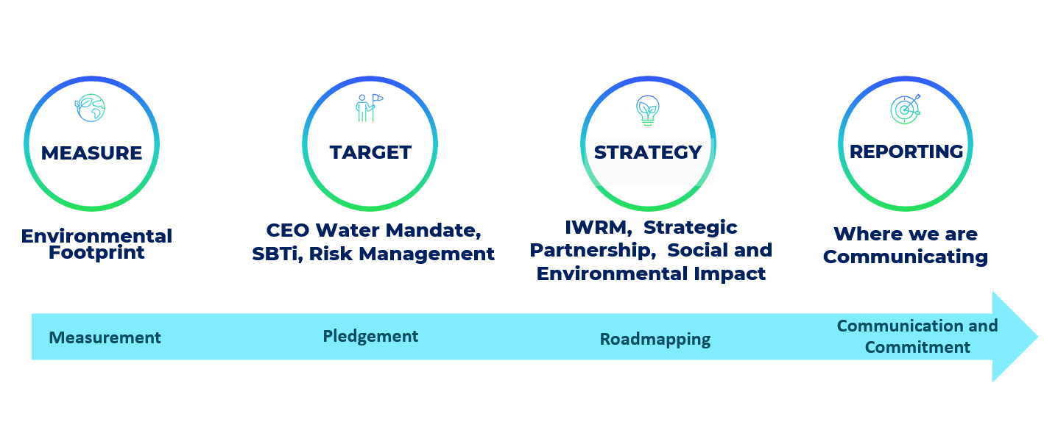

How to become Water Positive?
Gabriel Blejman

Slide 31

“The best time to become Water Positive was 20 years ago; the second-best time is now."
The Water Positive Think Tank
Thank you!

